Slide 1


MINI HPC CLUSTER
Amira Momtaz 231001071
Rowan Atef 231001403
Inji Hatem 231000596
Supervised by: Dr. Mohamed Mahmoud El Sayed
Code course: CBIO312

Slide 2

Project overview
Objectives
Approach
Implement a Mini‑HPC cluster (MPI) and a hybrid Big Data cluster (Docker Swarm + Apache Spark) to compare performance, scalability, and architecture.
Train and test distributed ML models on the same gene expression dataset across both platforms and analyze trade-offs.

Slide 3
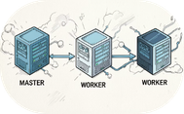


Materials & environment
Hardware / Tools
Cluster software
ML libraries & dataset
3 VirtualBox VMs (1 master + 2 workers) running Ubuntu Server 20.04; static IPs and passwordless SSH configured.
Docker, Docker Swarm, OpenMPI, mpi4py, Apache Spark (deployed with spark-stack.yml).
Python 3, scikit-learn, pandas, numpy, Spark MLlib; gene expression dataset for classification experiments.

Slide 4
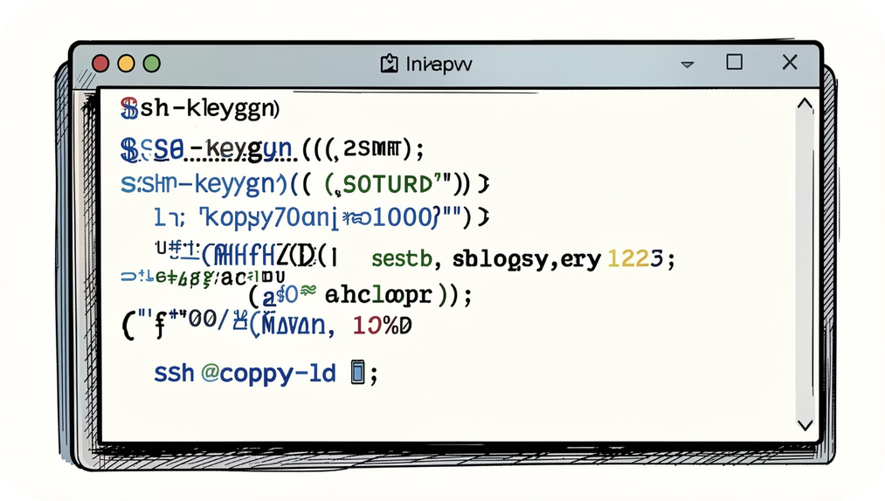
Methodology — setup
We provisioned three VMs and assigned static IPs. Passwordless SSH (ssh-keygen + ssh-copy-id) enabled seamless remote execution and MPI orchestration.
OpenMPI and mpi4py were installed for the Mini‑HPC experiments; Docker and Swarm initialized the containerized cluster for Spark.

Slide 5
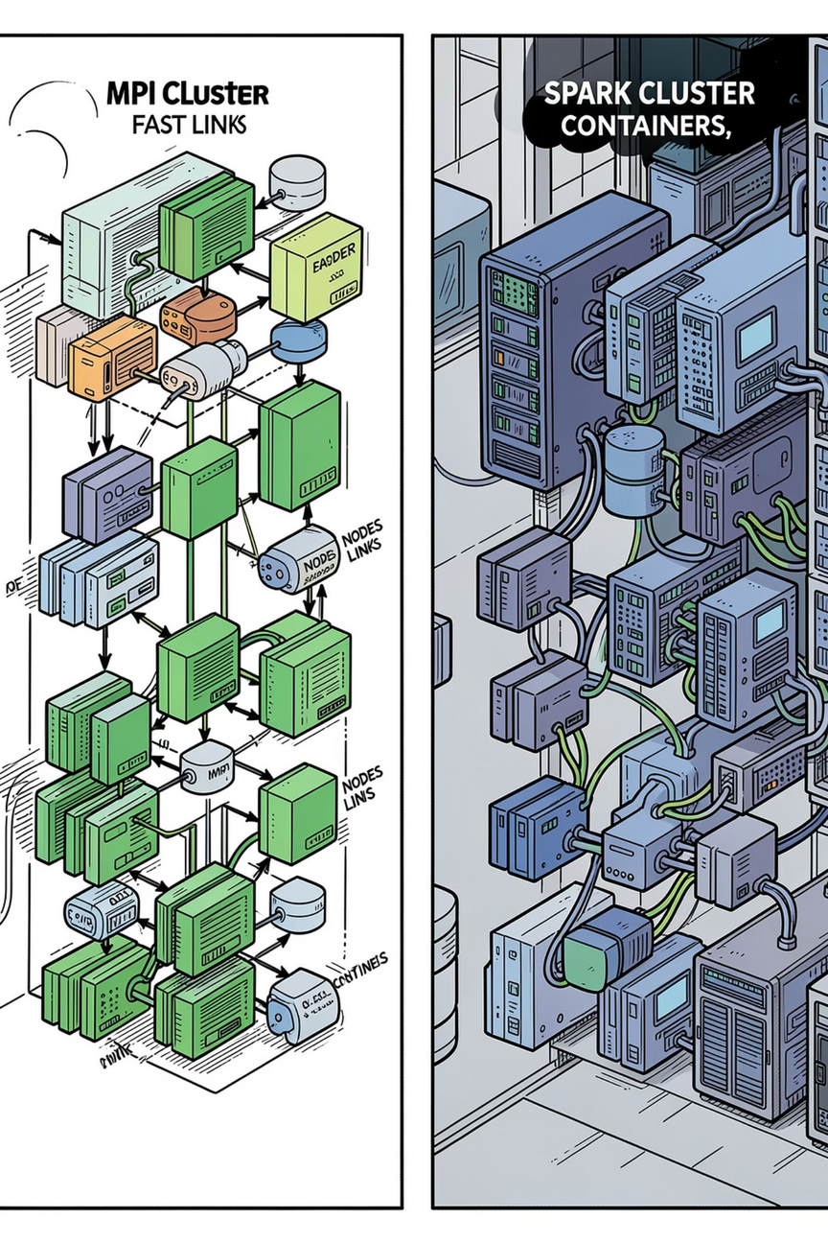
Methodology — workloads & experiments
Distributed ML tasks were implemented in both environments:
MPI: mpi4py programs that partition data and perform parallel training steps across worker nodes.
Spark: PySpark jobs using RDD/DataFrame pipelines and Spark MLlib for model training with fault-tolerant execution.
Experiments measured training time, resource utilization, recovery behavior, and classification accuracy on the gene expression dataset.

Slide 6
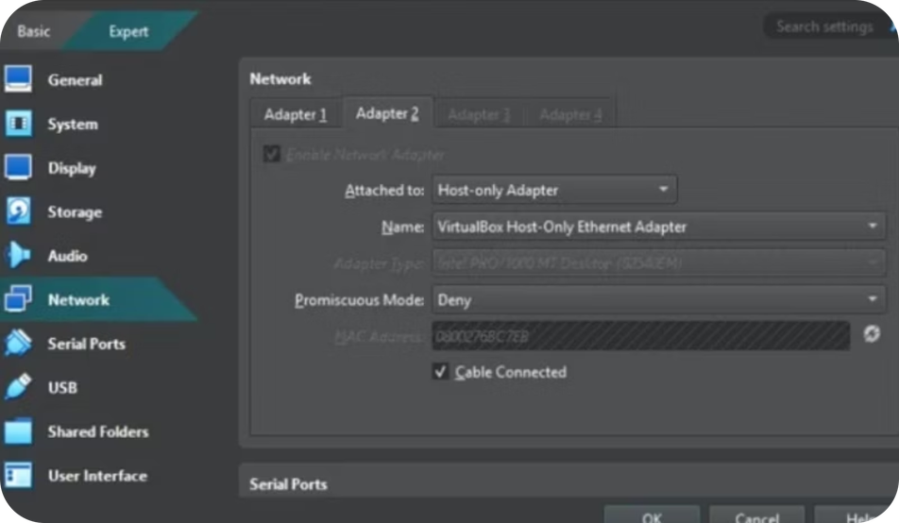
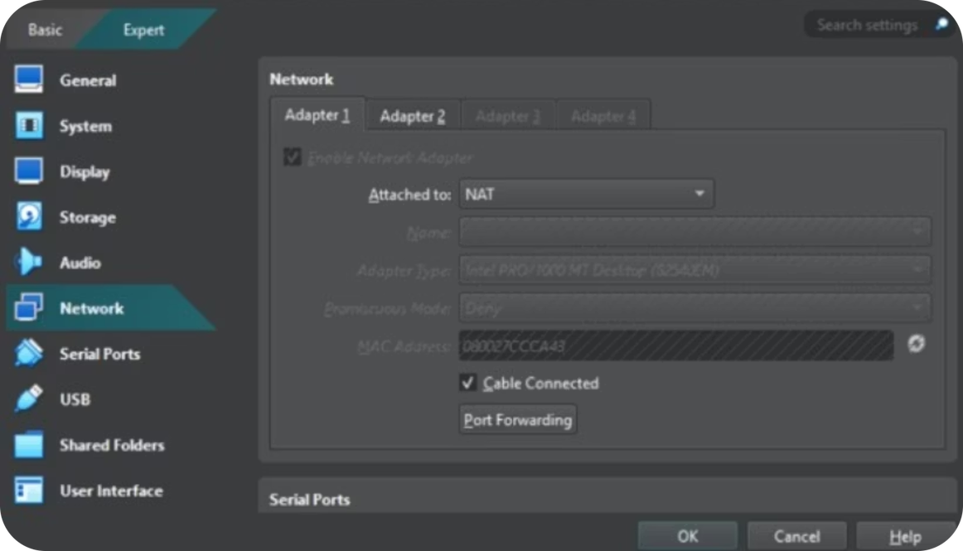
Network Setup for the 3 Virtual Machines:

Slide 7
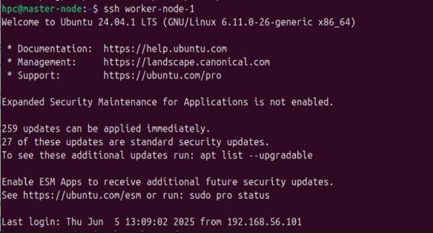
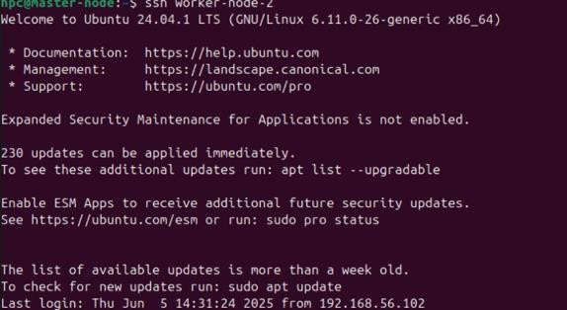
Results: SSH connection successful

Slide 8
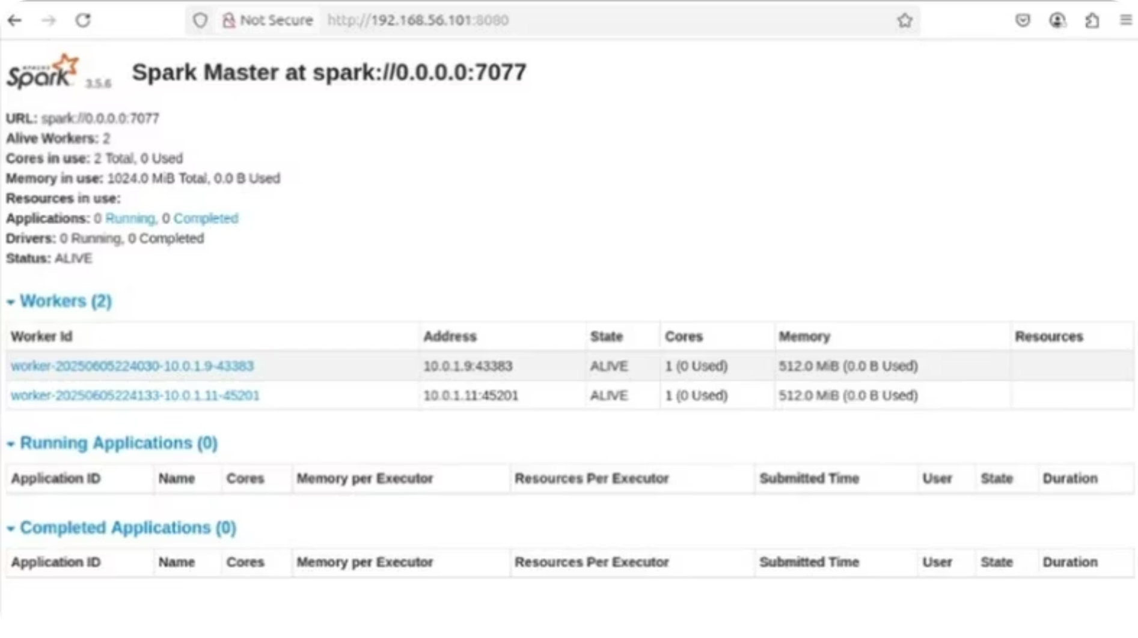
RESULTS:
Spark integration

Slide 9
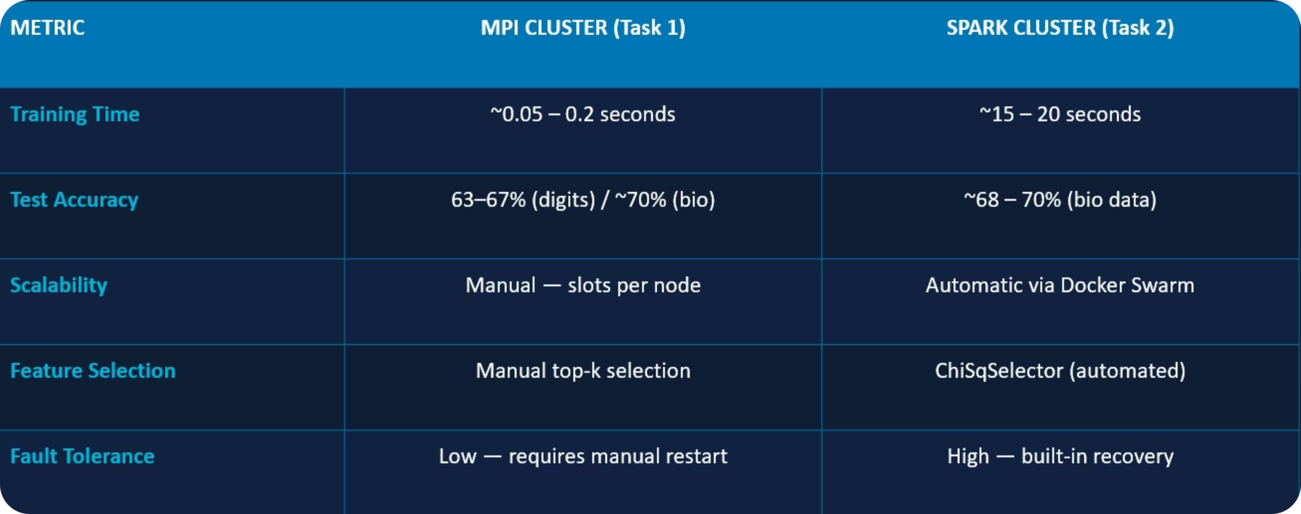
RESULT: Performance comparison

Slide 10
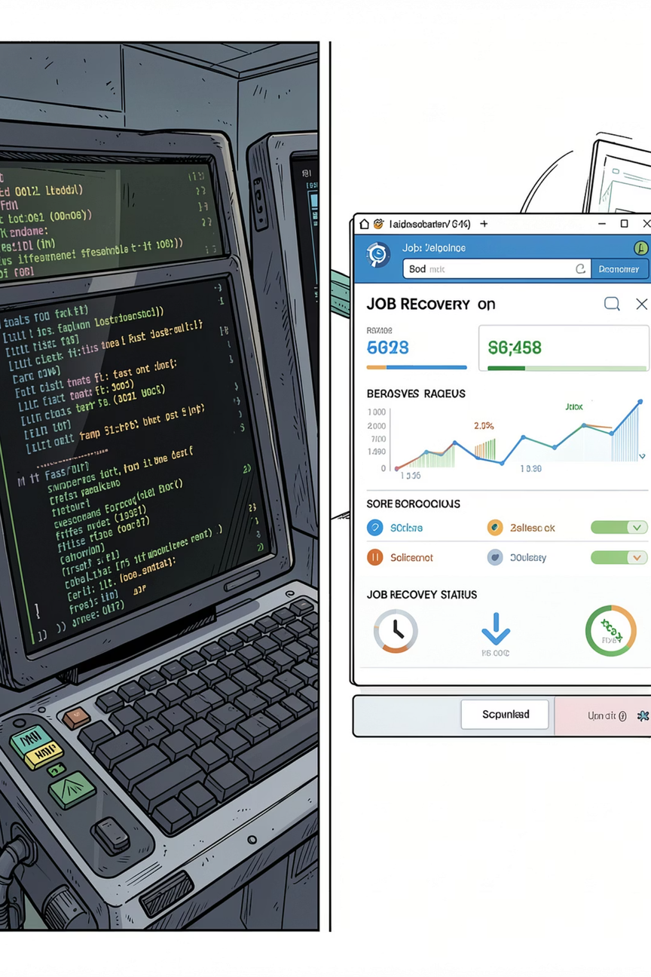
Discussion
Performance
Fault tolerance & management
MPI delivered faster training throughput for tightly-coupled tasks due to lightweight communication and minimal orchestration overhead.
Spark provided automatic recovery, task re-execution, and robust job management at the cost of higher orchestration overhead.
Hands-on learning
Configuring SSH, networking, and container orchestration gave practical experience in cluster administration and distributed debugging.

Slide 11
Conclusion & next steps
We built and evaluated two distributed architectures: a Mini‑HPC cluster using MPI/mpi4py and a hybrid Docker Swarm + Spark cluster. Both ran distributed ML on a bioinformatics gene expression dataset and produced accurate classification results.
Conclusion
Next steps
Choice between MPI and Spark depends on task coupling, need for fault tolerance, and operational complexity.
Populate result slides with measured metrics, produce comparative charts, and extend experiments to larger datasets and simulated network partitions.

Slide 12

THANK YOU !

